Slide 1
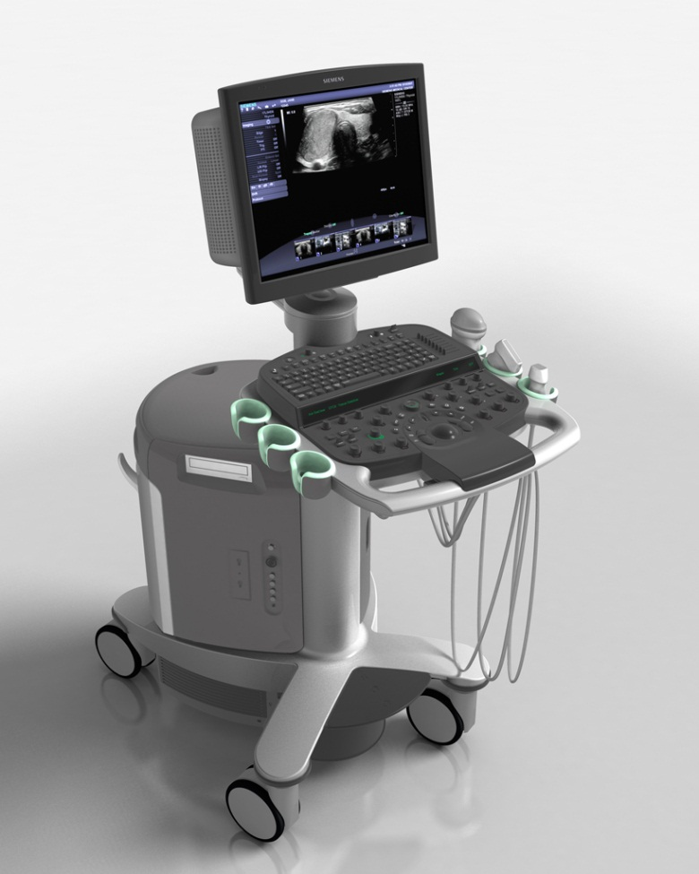
Siemens Acuson S2000 Ultrasound

Slide 2
Features
Dynamic tissue contrast enhancement
Spatial compounding
2D and spectral Doppler imaging
HD transducer support
Elastography / tissue strain imaging
Volumetric / 3D imaging
Automated lesion annotation tools

Slide 3
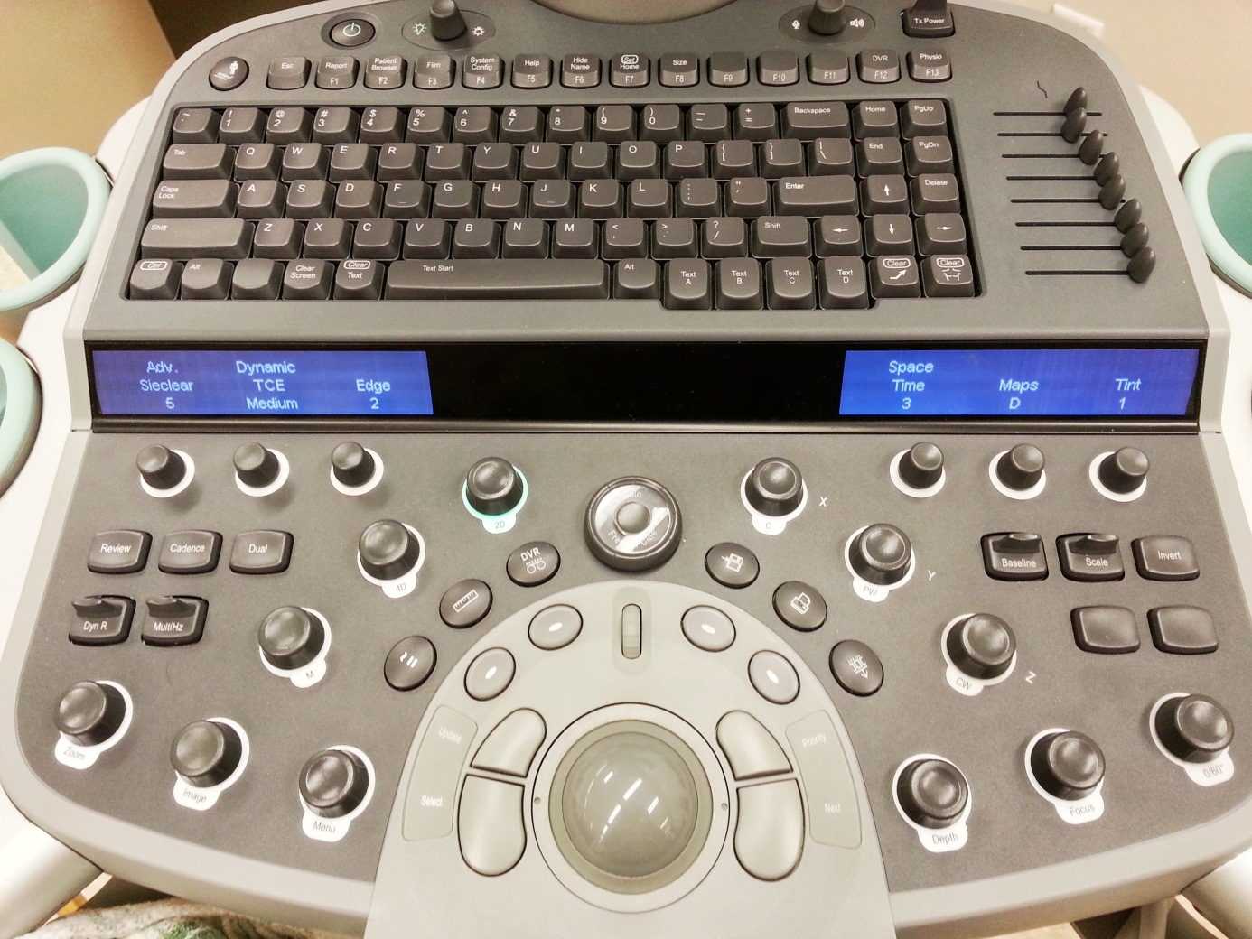
Ergonomic Workspace

Slide 4
Ergonomic Workspace
Dials for
adjusting
dynamic
parameters

Slide 5
Ergonomic Workspace
Dynamic
frequency
selection

Slide 6
Ergonomic Workspace
Cinematic
scrubber

Slide 7
Ergonomic Workspace
Doppler
imaging
controls

Slide 8
Ergonomic Workspace
Time-gain
compensation
adjustment

Slide 9
Ergonomic Workspace
Transmit
power
adjustment

Slide 10
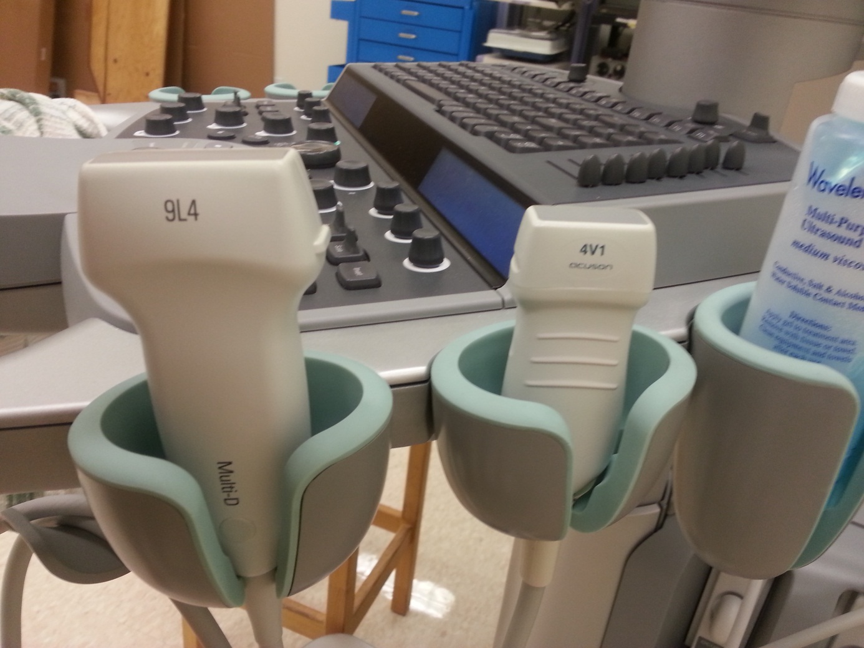
Transducers

Slide 11
Transducers
9L4
4 – 9 MHz linear transducer (“MultiHertz”)
“Multi-D” transducer (combines multiple frequencies for imaging)
Harmonic compounding
All forms of elastography
4V1
1 – 4.5 MHz linear Hanafy transducer (“MultiHertz”)
Harmonic compounding
Only ARFI and shear wave elastography
Numerous other transducers available

Slide 12
Elastography
Capable of:
Quasi-static (“eSie Touch Elasticity Imaging”)
Manually compress tissue
Acoustic Radiation Force Impulse (ARFI) (“Virtual Touch Imaging”)
Acoustic radiation compresses tissue
Shear Wave Speed Quantification (“Virtual Touch Quantification”)
Generate shear waves and measure velocity

Slide 13
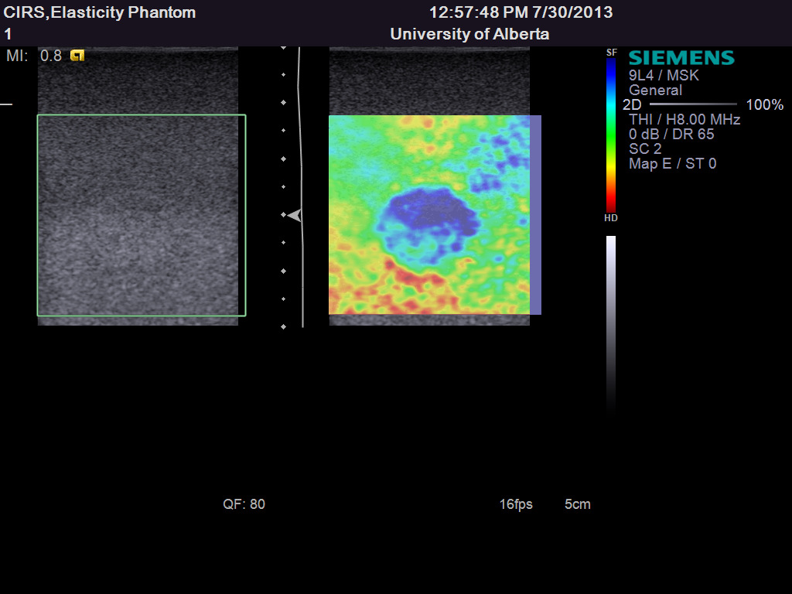
Quasi-Static Elastography

Slide 14
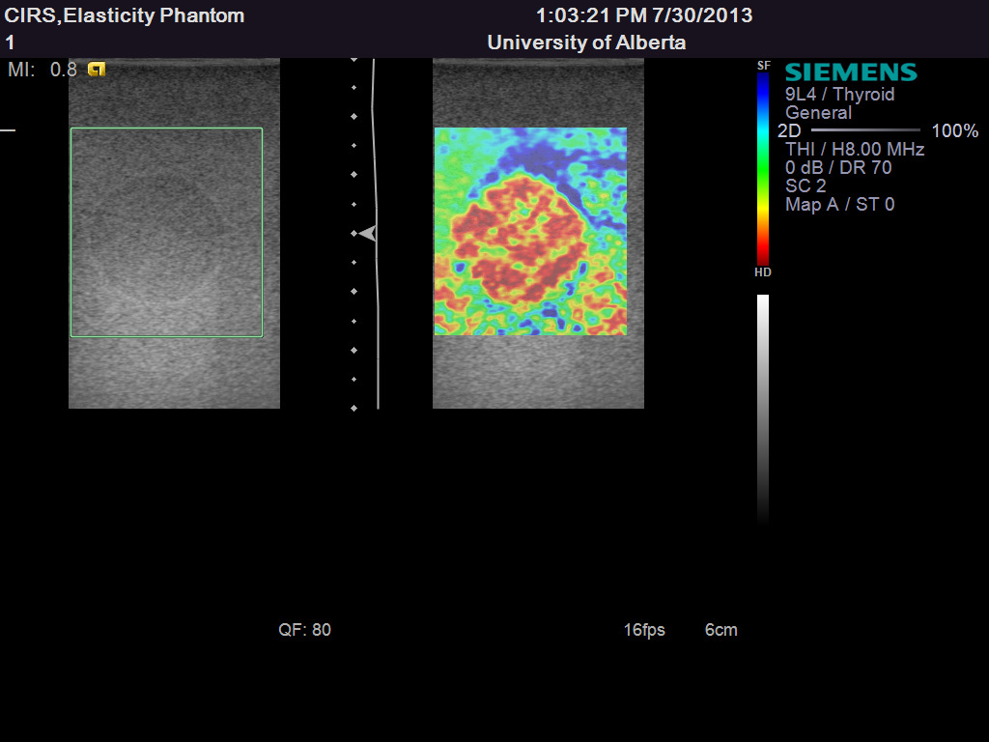
Quasi-Static Elastography

Slide 15
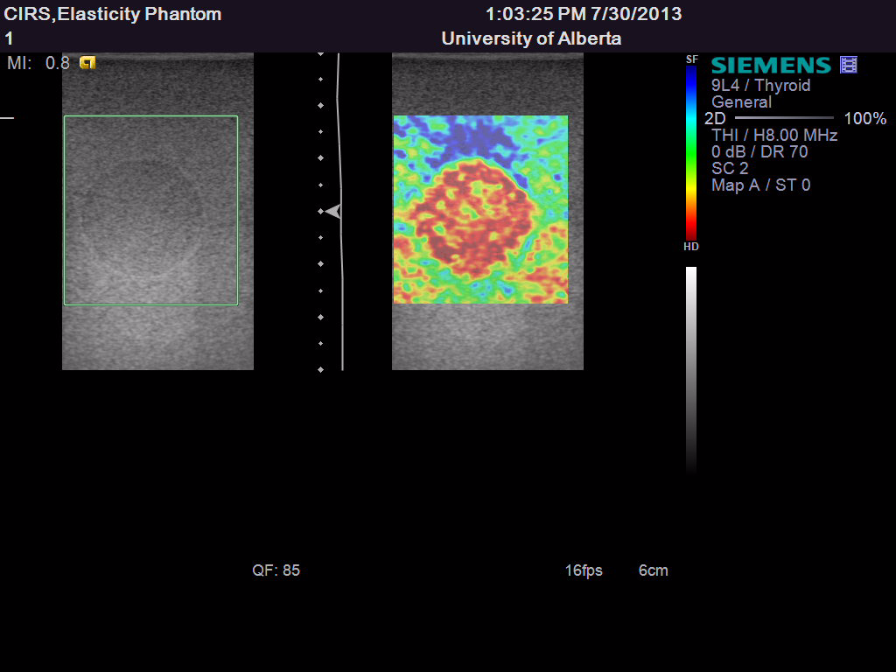
Quasi-Static Elastography Acquisition

Slide 16
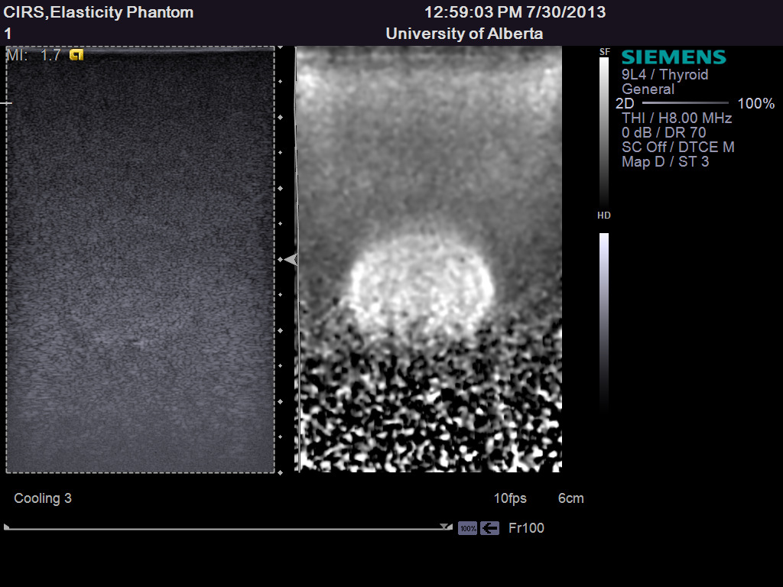
ARFI Imaging
Soft lesion

Slide 17
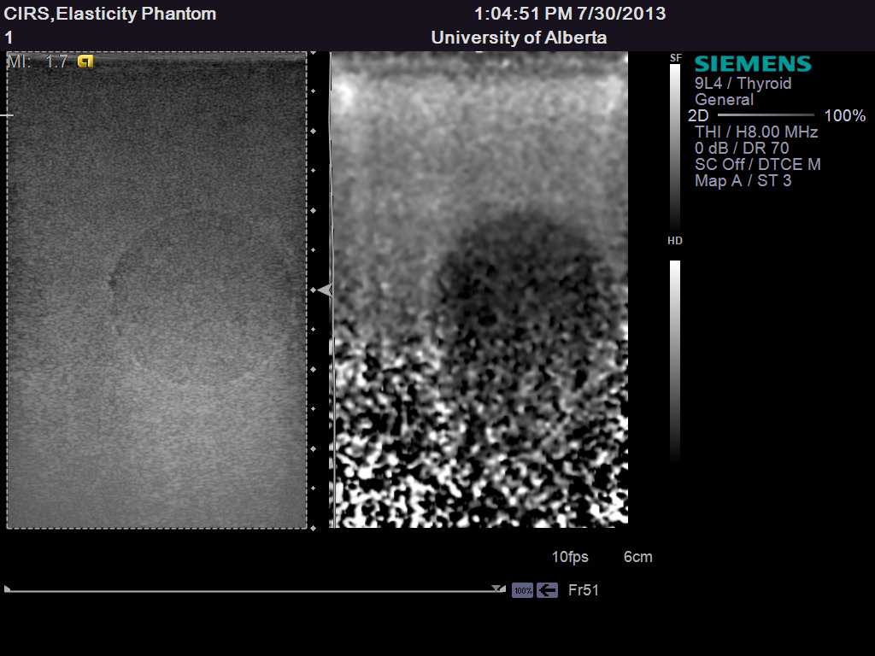
ARFI Imaging
Hard lesion
4 cm

Slide 18
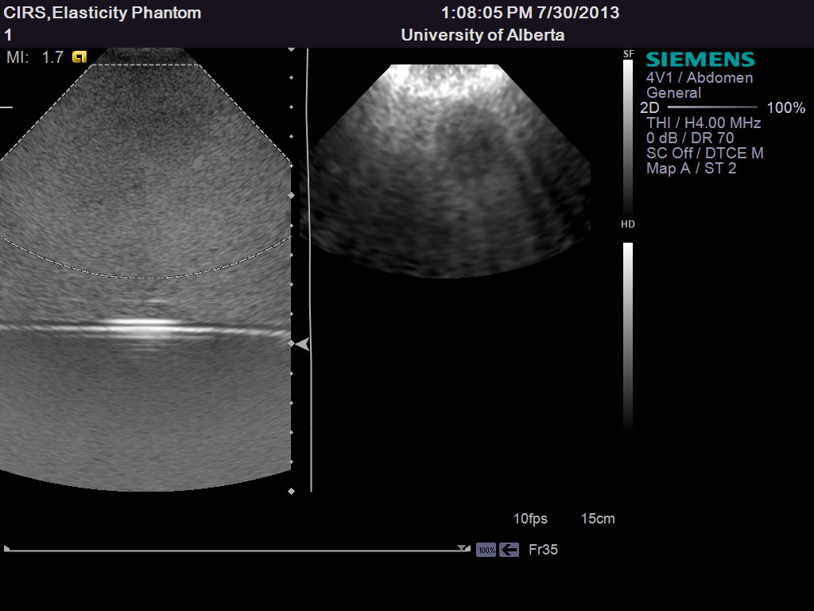
ARFI Imaging
Hard lesion

Slide 19
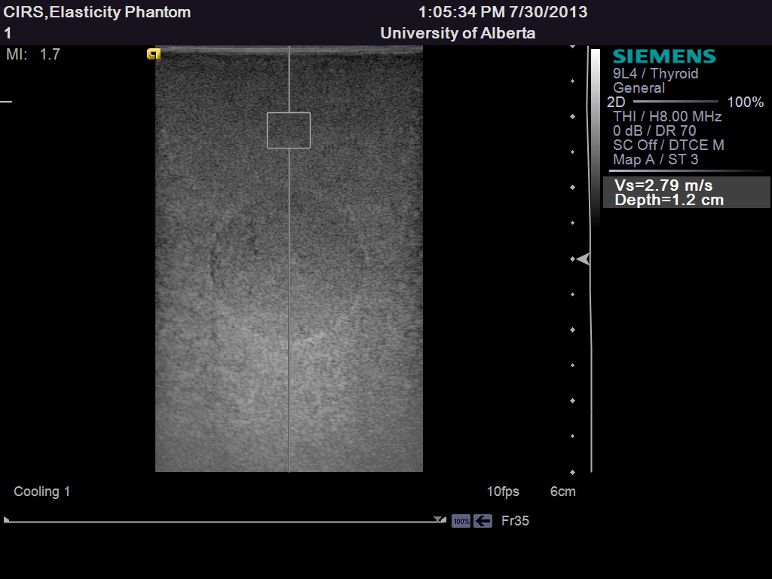
Shear Wave Speed Quantification
23.4 kPa

Slide 20
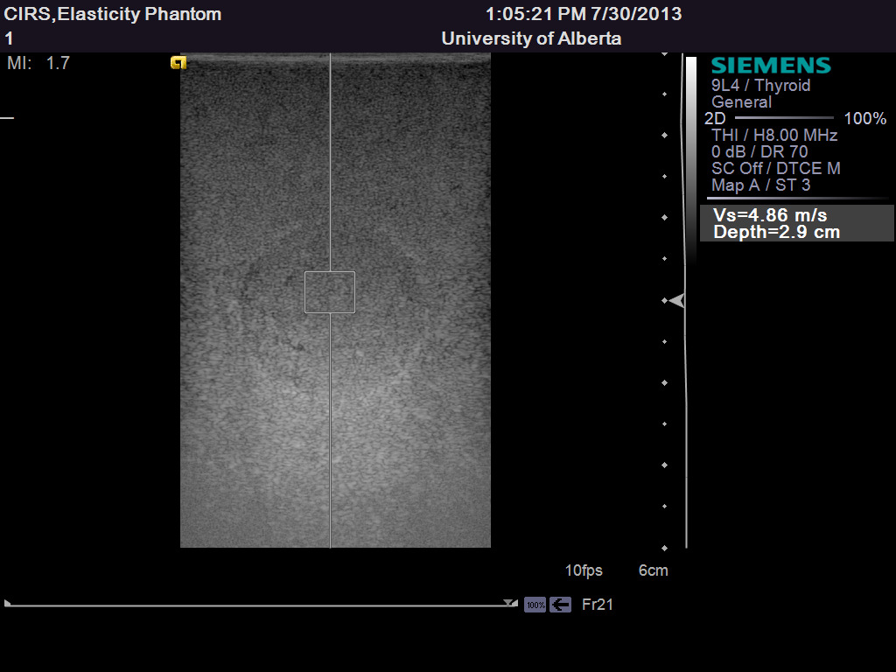
Shear Wave Speed Quantification
70.8 kPa
≈ 3× stiffer

Slide 21
Conclusions
Powerful and capable machine
Extensible and upgradeable with alternate transducers and software packages
Full elastography capability with two transducers

